Slide 1
Improve your application robustness with testing
and API documentation

Slide 2

Let’s get to know each other
*Image from pexels.com, by Ivan Samkov

Slide 3
Software Testing

Slide 4

What is Software Testing?
Software testing is a process of identifying the correctness of software by considering its all attributes (Reliability, Scalability, Portability, Re-usability, Usability) and evaluating the execution of software components to find the software bugs or errors or defects.
Testing is a group of techniques to determine the correctness of the application under the predefined script but, testing cannot find all the defects of application. It does not demonstrate that a product functions properly under all conditions but only that it is not working in some specific conditions.

Slide 5
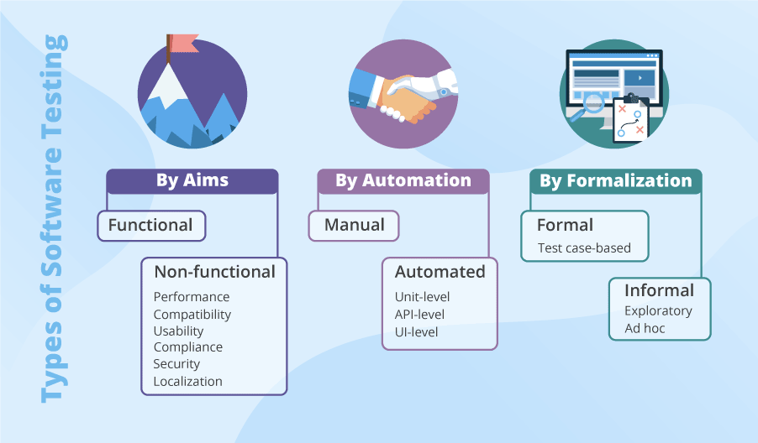
Types of Software testing

Slide 6
Principles of Software testing
Testing shows the Presence of Defects
It shows the defects but cannot prove that there are no defects. Meaning that the tests cannot say that the product is 100% defect-free.
Defect Clustering
Usually defects are related to a small number of modules. Software testing is approximately 80:20; which means 80% of the problems are found due to 20% of the modules.
Exhaustive Testing is Impossible
For instance, consider there are 15 fields in one endpoint which allow 5 possible values each. To test all combinations, you would need 30 517 578 125 (5^15) tests.
Testing is Context Dependent
In this approach, different types of applications can be tested differently and the same test cases cannot be applied for different projects.
Early Testing
The main advantage of early testing is that it can easily detect errors, bugs, and help in each level of development with fewer costs and efforts. Sometimes TDD is considered.
Absence of Errors Fallacy
If there are no bugs in the software, then you should not consider that software is ready to be used; because testing should be conducted along with the right requirements.

Slide 7
What do developers usually test?
A unit test is a piece of code written by a developer that executes a specific functionality in the code to be tested and asserts a certain behavior or state. A unit test targets a small unit of code, e.g., a method or a class. External dependencies should be removed from unit tests, e.g., by replacing the dependency with a test implementation or a (mock) object created by a test framework.
An integration test aims to test the behavior of a component or the integration between a set of components. The term functional test is sometimes used as synonym for integration test. Integration tests check that the whole system works as intended, therefore they are reducing the need for intensive manual tests.
Performance tests are used to benchmark software components repeatedly. Their purpose is to ensure that the code under test runs fast enough even if it’s under high load.

Slide 8
Unit Testing
Unit Tests in Java are commonly implemented using JUnit.
JUnit is a Java test framework and an open source project hosted at Github. JUnit 5 (also known as Jupiter) is the latest major release of JUnit.
A JUnit test is a method contained in a class which is only used for testing. This is called a Test class. To define that a certain method is a test method, annotate it with the @Test annotation.
This method executes the code under test. You use an assert method, provided by JUnit or another assert framework, to check an expected result versus the actual result. These calls are typically called asserts or assert statements.

Slide 9
Naming conventions
There are several potential naming conventions for JUnit tests. A widely-used solution for classes is to use the Test suffix at the end of test classes names.
As a general rule, a method name for a test should explain what the test does. If that is done correctly, reading the actual implementation can be avoided.
One possible convention is to use the "should" in the test method name. For example, ordersShouldBeCreated or menuShouldGetActive. This gives a hint what should happen if the test method is executed.
Another approach is to use given[ExplainYourInput]When[WhatIsDone]Then[ExpectedResult] for the display name of the test method.
With JUnit5 naming the test method is less important, as you can use the @DisplayName annotation to add a description for the test method.

Slide 10
Important JUnit annotations
JUnit uses annotations to mark methods as test methods and to configure them. The following table gives an overview of the most important annotations in JUnit 5. All these annotations are part of the org.junit.jupiter.api package.
Annotation | Description
@Test | Identifies a method as a test method.
@Disabled("reason") | Disables a test method with an option reason.
@BeforeEach | Executed before each test. Used to prepare the test environment, e.g., initialize the fields in the test class, configure the environment, etc.
@AfterEach | Executed after each test. Used to cleanup the test environment, e.g., delete temporary data, restore defaults, cleanup expensive memory structures.
@DisplayName("<Name>") | <Name> that will be displayed by the test runner. In contrast to method names the name can contain spaces to improve readability.
@RepeatedTest(<Number>) | Similar to @Test but repeats the test a <Number> of times
@BeforeAll | Annotates a method which is executed once, before the start of all tests. It is used to perform time intensive activities, for example, to connect to a database. Methods marked with this annotation need to be defined as static to work with JUnit.
@AfterAll | Annotates a method which is executed once, after all tests have been finished. It is used to perform clean-up activities, for example, to disconnect from a database. Methods annotated with this annotation need to be defined as static to work with JUnit.

Slide 11
JUnit Dependencies
<dependency>
<groupId>org.junit.jupiter</groupId>
<artifactId>junit-jupiter-engine</artifactId>
<version>5.7.0</version>
<scope>test</scope>
</dependency>
<dependency>
<groupId>org.junit.jupiter</groupId>
<artifactId>junit-jupiter-api</artifactId>
<version>5.7.0</version>
<scope>test</scope>
</dependency>

Slide 12
JUnit Demo

Slide 13

Mocking - Mockito, why drink it?
Mockito is a mocking framework that tastes really good. It lets you write beautiful tests with a clean & simple API. Mockito doesn’t give you hangover because the tests are very readable and they produce clean verification errors.
https://site.mockito.org/

Slide 14
Enable Mockito Annotations
In order to be able to use Mockito annotations we have to enable them.
The first option we have is to annotate the JUnit test with a MockitoExtension. Alternatively, we can enable Mockito annotations programmatically as well, by invoking MockitoAnnotations.initMocks().
@ExtendWith(MockitoExtension.class)
public class MockitoAnnotationTest {
...
}
@BeforeEach
public void init() {
MockitoAnnotations.initMocks(this);
}

Slide 15
Important Mockito annotations
The most used annotation in Mockito is @Mock. We can use @Mock to create and inject mocked instances. Same behaviour can be achieved using Mockito.mock(Object.class).
@Mock
List<String> mockedList;
@Test
public void whenUseMockAnnotation_thenMockIsInjected() {
mockedList.add("one");
Mockito.verify(mockedList).add("one");
assertEquals(0, mockedList.size());
Mockito.when(mockedList.size()).thenReturn(100);
assertEquals(100, mockedList.size());
}
@Test
public void whenNotUseMockAnnotation_thenCorrect() {
List mockList = Mockito.mock(ArrayList.class);
mockList.add("one");
Mockito.verify(mockList).add("one");
assertEquals(0, mockList.size());
Mockito.when(mockList.size()).thenReturn(100);
assertEquals(100, mockList.size());
}

Slide 16
Important Mockito annotations
@Spy - This will allow us to call all the normal methods of the object while still tracking every interaction, just as we would with a mock. Same behaviour can be achieved using Mockito.spy(real_object).
@Spy
List<String> spiedList = new ArrayList<String>();
@Test
public void whenUseSpyAnnotation_thenSpyIsInjectedCorrectly() {
spiedList.add("one");
spiedList.add("two");
Mockito.verify(spiedList).add("one");
Mockito.verify(spiedList).add("two");
assertEquals(2, spiedList.size());
// mock behavior can also be specified on a spy
Mockito.doReturn(100).when(spiedList).size();
assertEquals(100, spiedList.size());
}
@Test
public void whenNotUseSpyAnnotation_thenCorrect() {
List<String> spyList = Mockito.spy(new ArrayList<String>());
spyList.add("one");
spyList.add("two");
Mockito.verify(spyList).add("one");
Mockito.verify(spyList).add("two");
assertEquals(2, spyList.size());
// mock behavior can also be specified on a spy
Mockito.doReturn(100).when(spyList).size();
assertEquals(100, spyList.size());
}

Slide 17
Important Mockito annotations
@Captor annotation is used to create an ArgumentCaptor instance.
@Mock
List mockedList;
@Captor
ArgumentCaptor argCaptor;
@Test
public void whenUseCaptorAnnotation_thenTheSam() {
mockedList.add("one");
Mockito.verify(mockedList).add(argCaptor.capture());
assertEquals("one", argCaptor.getValue());
}
@Test
public void whenNotUseCaptorAnnotation_thenCorrect() {
List mockList = Mockito.mock(List.class);
ArgumentCaptor<String> arg = ArgumentCaptor.forClass(String.class);
mockList.add("one");
Mockito.verify(mockList).add(arg.capture());
assertEquals("one", arg.getValue());
}

Slide 18
Specifying mock behavior
We have two ways to do that: the when().thenDoSomething() and the doSomething().when() syntax.
When we call any of a Mock methods, Mockito registers that call. With the call of the when() method, Mockito knows that this invocation wasn't an interaction by the business logic. It was a statement that we want to assign some behavior to the mock object. After that, with one of the thenXxx() methods, we specify the expected behavior.
interface Employee {
String greet();
void workVoidRetType(DayOfWeek day);
}
@Test
void givenNonVoidMethod_callingWhen_shouldConfigureBehavior() {
// given
when(employee.greet()).thenReturn("Hello");
// when
String greeting = employee.greet();
// then
assertThat(is("Hello"), greeting);
}

Slide 19
Specifying mock behavior
@Test
void givenVoidMethod_callingWhen_wontCompile() {
// given
when(employee.workVoidRetType(DayOfWeek.SUNDAY)).thenThrow(new IAmOnHolidayException());
// when
Executable workCall = () -> employee.workVoidRetType(DayOfWeek.SUNDAY);
// then
assertThrows(IAmOnHolidayException.class, workCall);
}
The workVoidRetType() method has a void return type and, hence we cannot wrap it into another method call, like the when(employee.workVoidRetType()). For that reason, unfortunately, this code won't compile.

Slide 20
Specifying mock behavior
doXxx methods to the rescue!
@Test
void givenVoidMethod_callingDoThrow_shouldConfigureBehavior() {
// given
doThrow(new IAmOnHolidayException()).when(employee).work(DayOfWeek.SUNDAY);
// when
Executable workCall = () -> employee.work(DayOfWeek.SUNDAY);
// then
assertThrows(IAmOnHolidayException.class, workCall);
}
This syntax is slightly different than the previous one: we don't try to wrap a void method call inside another method call.
IMPORTANT: Sometimes it's impossible or impractical to use when().then() syntax for stubbing spies. Therefore when using spies please consider doReturn().when() | doAnswer().when | doThrow().when() family of methods for stubbing. - https://www.javadoc.io/doc/org.mockito/mockito-core/1.10.19/org/mockito/Mockito.html#13

Slide 21
Mockito Dependencies
<dependency>
<groupId>org.mockito</groupId>
<artifactId>mockito-core</artifactId>
<version>2.21.0</version>
<scope>test</scope>
</dependency>
<dependency>
<groupId>org.mockito</groupId>
<artifactId>mockito-junit-jupiter</artifactId>
<version>2.23.0</version>
<scope>test</scope>
</dependency>

Slide 22
Maven test lifecycle plugins
<plugin>
<artifactId>maven-surefire-plugin</artifactId>
<version>2.22.2</version>
<dependencies>
<dependency>
<groupId>org.junit.platform</groupId>
<artifactId>junit-platform-surefire-provider</artifactId>
<version>1.2.0</version>
</dependency>
</dependencies>
</plugin>
<plugin>
<artifactId>maven-failsafe-plugin</artifactId>
<version>2.22.2</version>
</plugin>

Slide 23
Mockito Demo

Slide 24
Integration Testing in Spring

Slide 25
Enable Spring in Tests with JUnit 5
JUnit 5 defines an extension interface through which classes can integrate with the JUnit test.
We can enable this extension by adding the @ExtendWith annotation to our test classes and specifying the extension class to load. To run the Spring test, we use SpringExtension.class.
We also need the @ContextConfiguration annotation to load the context configuration and @WebAppConfiguration which bootstraps the context that our test will use.
@ExtendWith(SpringExtension.class)
@ContextConfiguration(classes = { FrontControllerConfig.class, AppConfig.class })
@WebAppConfiguration
public class UserControllerIntegrationTest {
....
}

Slide 26
Enable Spring in Tests with JUnit 5
WebApplicationContext provides a web application configuration. It loads all the application beans (controllers, services etc.) into the context. We'll now be able to wire the web application context right into the test:
@Autowired
private WebApplicationContext webApplicationContext;
MockMvc provides support for Spring MVC testing. It encapsulates all web application beans and makes them available for testing.
private MockMvc mockMvc;
@BeforeEach
private void setUp() {
this.mockMvc = MockMvcBuilders.webAppContextSetup(this.webApplicationContext).build();
}

Slide 27
Verify Test Configuration
Verify that we're loading the WebApplicationContext object (webApplicationContext) properly and also check that the right servletContext is being attached and that a bean named userController exists in the context
@Test
public void shouldFindPostControllerBeanInServletContext() {
ServletContext servletContext = webApplicationContext.getServletContext();
assertNotNull(servletContext);
assertTrue(servletContext instanceof MockServletContext);
assertNotNull(webApplicationContext.getBean("userController"));
}

Slide 28
Verify View Name
Considering you invoke the /homePage endpoint from our app as: http://localhost:8080/spring-mvc-test/ or http://localhost:8080/spring-mvc-test/homePage, depending on your context-path and home page
@Test
public void givenHomePageURIWhenMockMVCThenReturnsIndexJSPViewName() {
this.mockMvc.perform(get("/homePage"))
.andDo(MockMvcResultHandlers.print())
.andExpect(MockMvcResultMatchers.view().name("index"));
}
Let's break it down:
perform() method will call a GET request method, which returns the ResultActions. Using this result, we can have assertion expectations about the response, like its content, HTTP status, or header
andDo(print()) will print the request and response. This is helpful to get a detailed view in case of an error
andExpect() will expect the provided argument. In our case, we're expecting “index” to be returned via MockMvcResultMatchers.view()

Slide 29
Verify Response Body
We'll invoke the /greet endpoint from our test as: http://localhost:8080/spring-mvc-test/greet
The expected output will be:
{
"id": 1,
"message": "Hello World!!!"
}
The test should be:
@Test
public void givenGreetURIWhenMockMVCThenVerifyResponse() {
MvcResult mvcResult = this.mockMvc.perform(MockMvcRequestBuilders.get("/greet"))
.andDo(MockMvcResultHandlers.print()).andExpect(MockMvcResultMatchers.status().isOk())
.andExpect(jsonPath("$.message").value("Hello World!!!"))
.andReturn();
Assert.assertEquals("application/json;charset=UTF-8",
mvcResult.getResponse().getContentType());
}

Slide 30
Send GET Request With Path Variable
Having a REST endpoint with a Path Variable like this: http://localhost:8080/spring-mvc-test/greetWithPathVariable/John which returns the following JSON:
{
"id": 1,
"message": "Hello World John!!!"
}
The test should be:
@Test
public void givenGreetURIWithPathVariableWhenMockMVCThenResponseOK() {
this.mockMvc
.perform(get("/greetWithPathVariable/{name}", "John"))
.andDo(print()).andExpect(status().isOk())
.andExpect(content().contentType("application/json;charset=UTF-8"))
.andExpect(jsonPath("$.message").value("Hello World John!!!"));
}

Slide 31
Send GET Request With Query Parameters
Having a REST endpoint with a Query Parameter like this: http://localhost:8080/spring-mvc-test/greetWithQueryVariable?name=John%20Doe which returns the following:
{
"id": 1,
"message": "Hello World John Doe!!!"
}
The test should be:
@Test
public void givenGreetURIWithQueryParameterWhenMockMVCThenResponseOK() {
this.mockMvc.perform(get("/greetWithQueryVariable")
.param("name", "John Doe")).andDo(print()).andExpect(status().isOk())
.andExpect(content().contentType("application/json;charset=UTF-8"))
.andExpect(jsonPath("$.message").value("Hello World John Doe!!!"));
}

Slide 32
Integration Tests Dependencies
<dependency>
<groupId>org.springframework</groupId>
<artifactId>spring-test</artifactId>
<version>5.3.3</version>
<scope>test</scope>
</dependency>
----------------------------------------
<dependency>
<groupId>org.hamcrest</groupId>
<artifactId>hamcrest-library</artifactId>
<version>2.2</version>
<scope>test</scope>
</dependency>
<dependency>
<groupId>com.jayway.jsonpath</groupId>
<artifactId>json-path</artifactId>
<version>2.5.0</version>
<scope>test</scope>
</dependency>

Slide 33
Spring Integration Tests Demo

Slide 34
API Documentation

Slide 35

API documentation
The State of API Economy Report 2021
In 2020, virtually all industries, from retail and manufacturing to finance and hospitality, shifted how they do business.
APIs are central to organizations’ needs and digital transformation efforts.
APIs are the backbone of digital business ecosystems that encompass networks of partners, developers, and customers.

Slide 36
API documentation
API is the acronym for Application Programming Interface, which is a software intermediary that allows two applications to talk to each other.
Web application:
front-end and back-end components
expose APIs as a back-end component for the front-end component or third-party app integrations
good user experience is key to using any product - the same holds true for APIs.
It is essential to have proper specifications/documentation of the back-end APIs:
should be informative, readable, and easy to follow
should simultaneously describe every change in the API
should allow your API consumers to adopt it into their application quickly.

Slide 37
What is API Documentation ?

Slide 38
API documentation
The information that is required to successfully consume and integrate with an API.
The first interface that’s used by users and customers to consume your API offering.

Slide 39
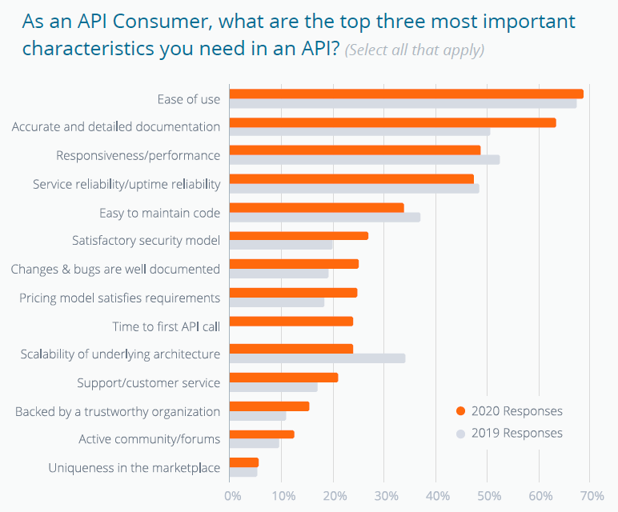
API documentation

Slide 40
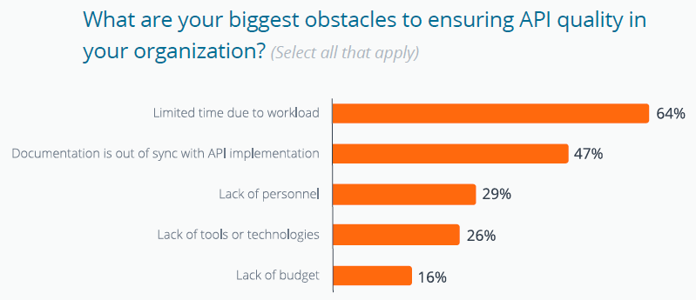
API documentation

Slide 41
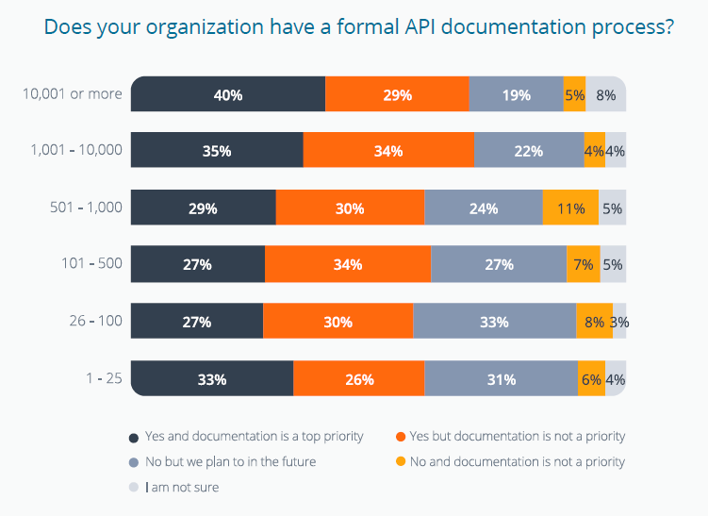
API documentation

Slide 42
API documentation
Conclusions - API Documentation:
a critical element in the API lifecycle and vital link between API providers and consumers.
can sometimes be the difference between a successful API that receives ample adoption, and one that’s problematic and ultimately avoided.
good documentation accelerates development and consumption, and reduces the money and time that would otherwise be spent answering support calls.

Slide 43
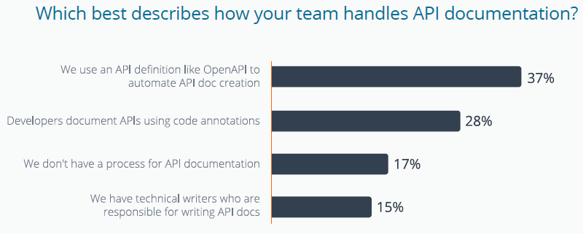
API documentation

Slide 44
Open API

Slide 45
API documentation
OAS (Open API Specification), formerly Swagger Specification
the most popular and used by many big companies
gives you the ability to design your API in a way that can be easily consumed by humans as well as machines
an API description format for REST APIs

Slide 46
API documentation
Swagger
a set of open-source tools built around the OpenAPI Specification that can help you design, build, document and consume REST APIs.
The major Swagger tools include:
Swagger Editor – browser-based editor where you can write OpenAPI specs.
Swagger UI – renders OpenAPI specs as interactive API documentation.
Swagger Codegen – generates server stubs and client libraries from an OpenAPI spec.

Slide 47
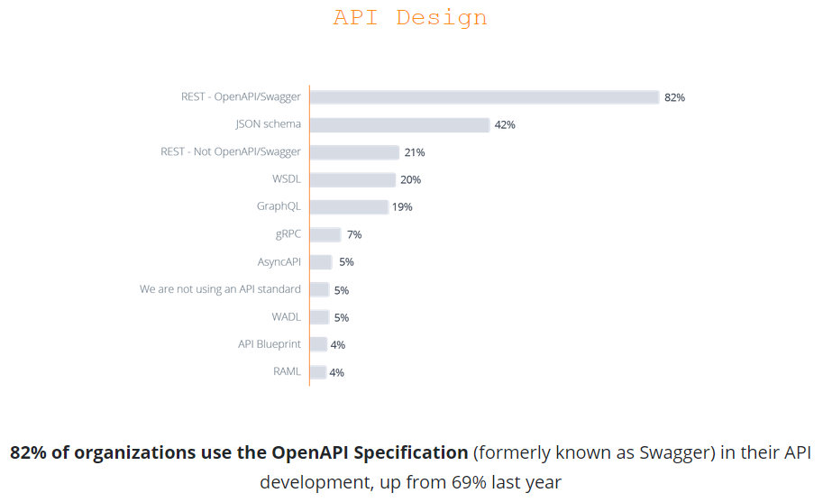
API documentation

Slide 48
API documentation
Open API
OAS defines an API’s contract
describes what the API does
describe it’s request parameters and response objects
describe all this without any indication of code implementation.
Benefits of defining your API with OpenAPI:
generating documentation for your API
help internal team members understand the API and agree on its attributes
help external users understand the API and what it can do
create tests for your API
generate implementation code and SDKs

Slide 49
API documentation
Approaches to Open API
Design First
Code First

Slide 50
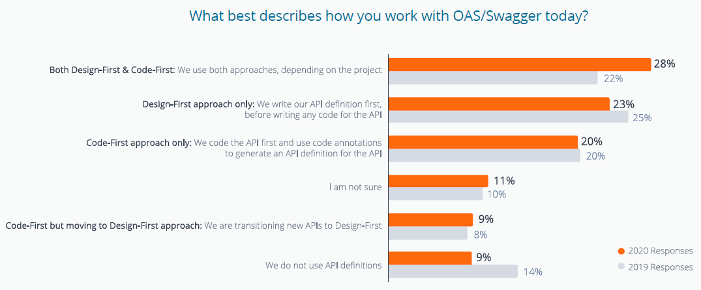
API documentation

Slide 51
API documentation
How to generate OpenAPI from existing APIs ?
Using the Swagger Inspector
https://swagger.io/tools/swagger-inspector/
insert the end point of the resource you want to have documented.
navigate to the right panel from the History section of Swagger Inspector, and click "Create API definition" to create the OAS definition.
OAS generation during runtime
Swagger-core is the Java implementation of Swagger
the Swagger/OAS contract is generated from an API based on the meta-data added against the various resources, methods and controllers.
Swagger generation during build time
the OAS contract is generated when preprocessing the API, that is, before runtime.
comments against various resources, methods and functions within the API help generate the OAS definition.

Slide 52
API documentation
OAS generation during runtime - steps:
Adding dependencies to your application
Hooking Swagger Core to the Application
Initialize the OAS Contract

Slide 53
API documentation
1. Adding dependencies to your application
SpringFox project provides Swagger support for Spring based REST APIs
Add the dependency in the pom.xml file (OpenAPI 3 or Swagger 2):
<dependency>
<groupId>io.springfox</groupId>
<artifactId>springfox-oas</artifactId>
<version>3.0.0</version>
</dependency>
<dependency>
<groupId>io.springfox</groupId>
<artifactId>springfox-swagger2</artifactId>
<version>2.9.2</version>
</dependency>
Note: If it’s not already in the pom.xml file, add also the jackson dependency for content marshalling and unmarshalling.
<dependency>
<groupId>com.fasterxml.jackson.core</groupId>
<artifactId>jackson-databind</artifactId>
<version>2.13.2</version>
</dependency>

Slide 54
API documentation
2. Hooking Swagger Core to the Application
2.1.1 For OpenAPI add an configuration class with @Configuration, @EnableOpenApi and @EnableWebMVC annotations
2.1.2 For Swagger add an configuration class with @EnableSwagger2 and @EnableWebMVC annotations
@Configuration
@EnableWebMvc
@EnableOpenApi
@ComponentScan("ro.info.iasi.fiipractic")
public class SwaggerConfig {
}
@EnableWebMvc
@EnableSwagger2
@ComponentScan("ro.info.iasi.fiipractic")
public class SwaggerConfig {
}
2.2. In the git examples for Session 3, the SwaggerConfig.class must be added to the list of getRootConfigClasses()
public class FrontControllerConfig extends AbstractAnnotationConfigDispatcherServletInitializer {
@Override
protected Class<?>[] getRootConfigClasses() {
return new Class[] { AppConfig.class, SwaggerConfig.class };
}

Slide 55
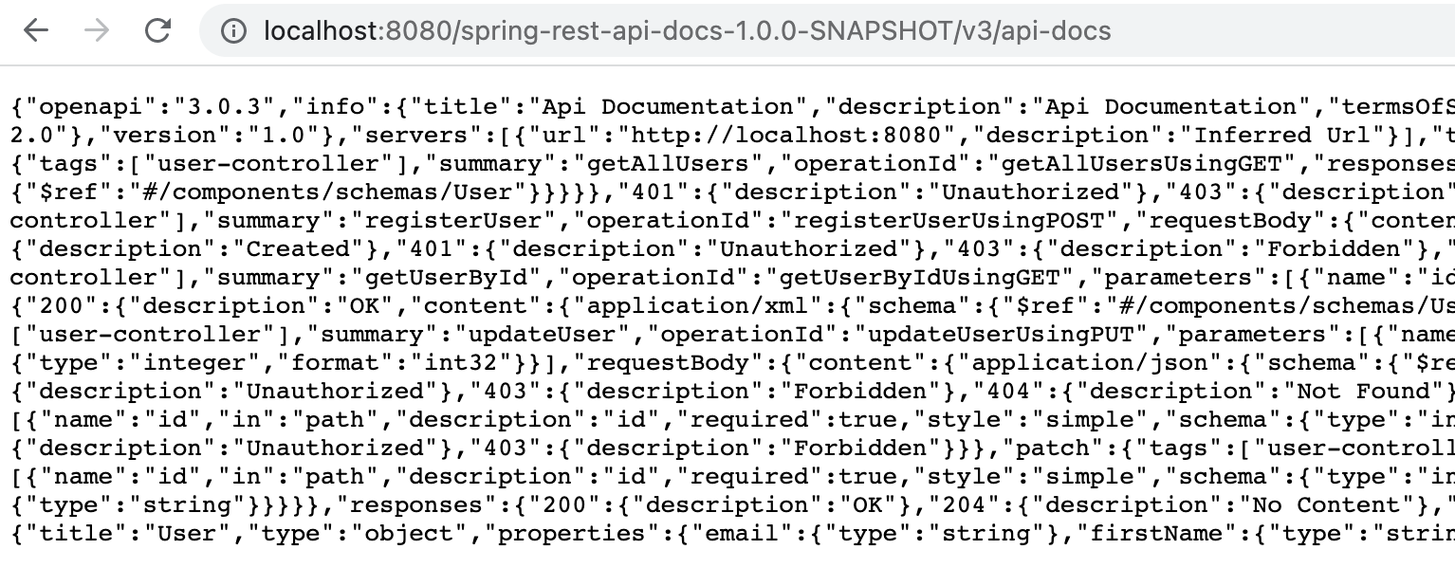
API documentation
2. Hooking Swagger Core to the Application
to verify that Springfox is working, we can visit this URL in our browser:
OpenAPI - http://localhost:8080/name_of_our_api/v3/api-docs
Swagger2 - http://localhost:8080/name_of_our_api/v2/api-docs
the result is a JSON response with a large number of key-value pairs - not very human readable.

Slide 56
Swagger UI

Slide 57
API documentation - Swagger UI
a built-in solution that makes user interaction with the Swagger-generated API documentation much easier.
add an additional Maven dependency in the pom.xml file (OpenAPI 3 or Swagger 2):
<dependency>
<groupId>io.springfox</groupId>
<artifactId>springfox-swagger-ui</artifactId>
<version>3.0.0</version>
</dependency>
<dependency>
<groupId>io.springfox</groupId>
<artifactId>springfox-swagger-ui</artifactId>
<version>2.9.2</version>
</dependency>

Slide 58
API documentation - Swagger UI
OpenAPI 3 version
Swagger UI adds a set of resources that we must configure as part of a class that implements WebMvcConfigurer and is annotated with @Component. This class can be placed in the config package.
@Component
public class SwaggerUiWebMvcConfigurer implements WebMvcConfigurer {
@Override
public void addResourceHandlers(ResourceHandlerRegistry registry) {
registry
.addResourceHandler("/swagger-ui/**")
.addResourceLocations("classpath:/META-INF/resources/webjars/springfox-swagger-ui/")
.resourceChain(false);
}
}

Slide 59
API documentation - Swagger UI
Swagger 2 version
Swagger UI adds a set of resources that we must configure as part of a class that implements WebMvcConfigurer and is annotated with @Configuration and @EnableWebMvc
also, we must add @Import(SwaggerConfig.class). This class can be placed in the config package.
@Configuration
@EnableWebMvc
@Import(SwaggerConfig.class)
public class SwaggerUiWebMvcConfigurer implements WebMvcConfigurer {
@Override
public void addResourceHandlers(ResourceHandlerRegistry registry) {
registry.addResourceHandler("swagger-ui.html")
.addResourceLocations("classpath:/META-INF/resources/");
registry.addResourceHandler("/webjars/**")
.addResourceLocations("classpath:/META-INF/resources/webjars/");
}
}

Slide 60
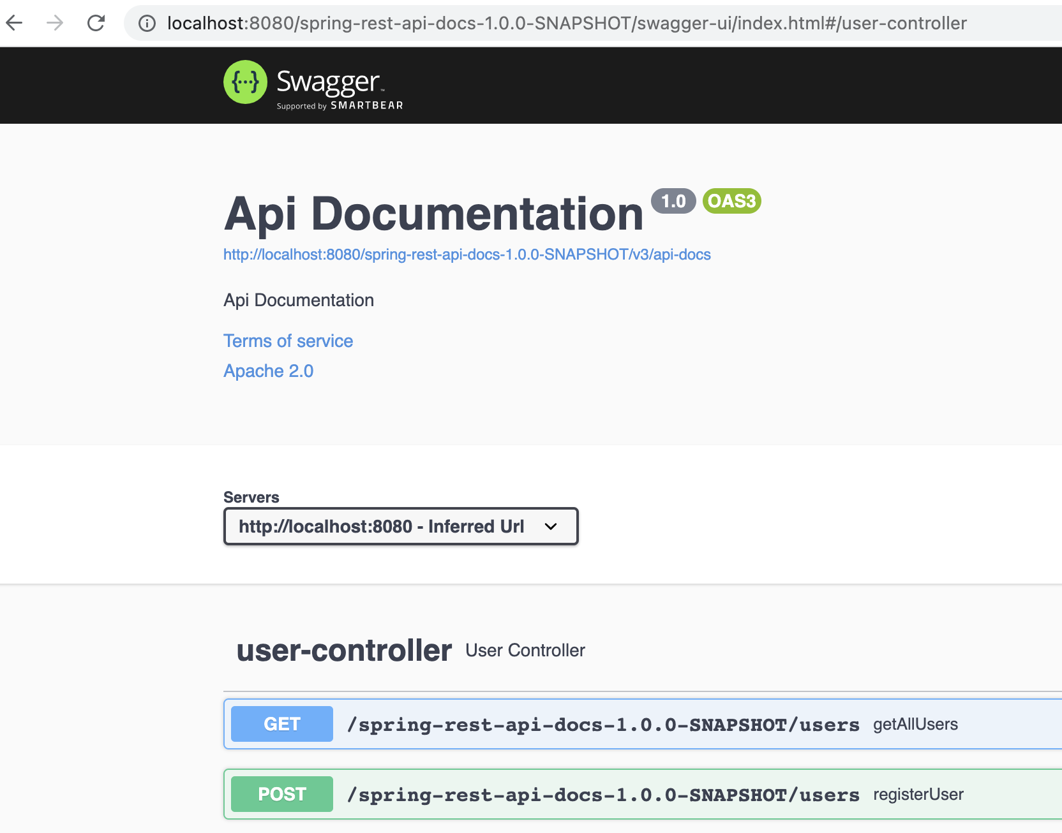
API documentation - Swagger UI
Test it in our browser by visiting:
OpenAPI 3 - http://localhost:8080/name_of_our_api/swagger-ui/index.html
Swagger 2 - http://localhost:8080/name_of_our_api/swagger-ui.html

Slide 61
API documentation - Swagger UI
Exploring Swagger Documentation
Displays the list of all controllers defined in our application.
For any of them will list the valid HTTP methods (DELETE, GET, HEAD, OPTIONS, PATCH, POST, PUT).
For each method provides additional useful data - response status, content-type, and a list of parameters.
It is also possible to try each method using the UI.

Slide 62
API documentation - Swagger UI
Swagger - synchronized with the code
Swagger’s ability to be synchronized with our code base is crucial.
To demonstrate this, we can add a new controller to our application
@RestController
@RequestMapping("/custom")
public class CustomController {
@GetMapping
public String custom() {
return "Response from the new controller !";
}
}
Rebuild, recreate war, restart the app and refresh the Swagger documentation page.

Slide 63
Advanced Swagger UI

Slide 64
API documentation - Swagger UI - Advanced Settings
Filtering API for Swagger’s Response
by passing parameters to the apis() and paths() methods of the Docket class.
RequestHandlerSelectors can be used to filter the API according to the base package, class annotation, and method annotations.
PathSelectors provides additional filtering with predicates, which scan the request paths of our application (any(), none(), regex(), or ant()).
@Configuration
@EnableWebMvc
@EnableOpenApi
@ComponentScan("ro.info.iasi.fiipractic")
public class SwaggerConfig {
@Bean
public Docket api() {
return new Docket(DocumentationType.OAS_30)
.select()
.apis(RequestHandlerSelectors.basePackage("ro.info.iasi.fiipractic.controller"))
// .paths(PathSelectors.any()) // display all endpoints
.paths(PathSelectors.ant("/spring-rest-api-docs-1.0.0-SNAPSHOT/user*"))
.build();
}
}

Slide 65
API documentation - Swagger UI - Advanced Settings
Swagger - Custom docs
Swagger provides some default values in its response, which we can customize:
“Api Documentation”, “Created by Contact Email”, “Apache 2.0”.
apiInfo(ApiInfo metadata) method of the Docket class can be used to change these values
ApiInfo - class that contains custom information about the API
(...)
return new Docket(DocumentationType.OAS_30). (...) .build().apiInfo(metadata());
}
private ApiInfo metadata() {
return new ApiInfoBuilder()
.title("TWITTER REST API")
.description("Some custom description of API.")
.version("API TOS")
.termsOfServiceUrl("Terms of service")
.contact(new Contact("John Doe", "www.softvision.com", "me@softvision.com"))
.license("License of API")
.licenseUrl("API license URL")
.build();
}

Slide 66
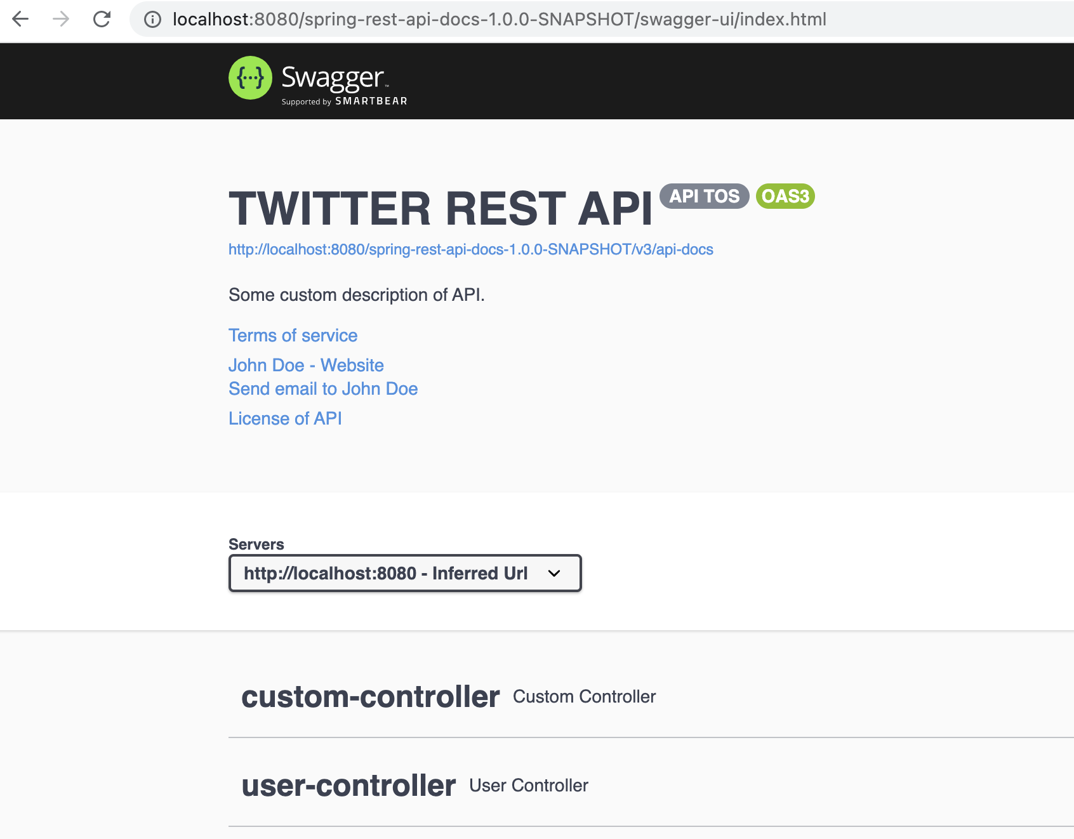
API documentation - Swagger UI - Advanced Settings

Slide 67
OpenAPI with SpringBoot

Slide 68
API documentation in SpringBoot
1. Adding dependencies to your application
SpringDoc project provides OpenAPI support for SpringBoot based REST APIs
Add the dependency in the pom.xml file:
<dependency>
<groupId>org.springdoc</groupId>
<artifactId>springdoc-openapi-ui</artifactId>
<version>1.6.4</version>
</dependency>
2. Verify OpenAPI and Swagger UI
to verify that SpringDoc is working, we can visit this URL in our browser:
OpenAPI - http://localhost:8080/v3/api-docs
Swagger UI - http://localhost:8080/swagger-ui.html

Slide 69
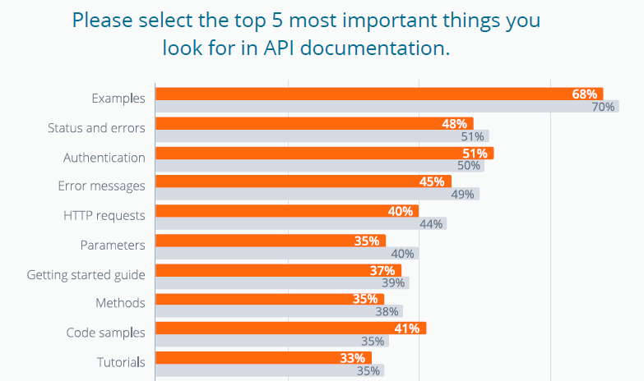
API documentation

Slide 70
API documentation in SpringBoot
Adding more details to our Swagger UI by using annotations:
add @Operation and @ApiResponses to the /users/{id} endpoint in the UserController
@Operation(summary = "Get a user by its id")
@ApiResponses(value = {
@ApiResponse(responseCode = "200", description = "Found the user",
content = { @Content(mediaType = "application/json",
schema = @Schema(implementation = User.class)) }),
@ApiResponse(responseCode = "400", description = "Invalid id supplied",
content = @Content),
@ApiResponse(responseCode = "404", description = "User not found",
content = @Content) })
@GetMapping(value = "/users/{id}", produces = MediaType.APPLICATION_JSON_VALUE)
public User getUserById(@PathVariable Integer id) {
return userService.getUserById(id);
}

Slide 71
Lab exercises

Slide 72
Lab exercises
Tests
Add unit tests for your services and repositories
Add integration tests for your controllers
OpenAPI 3
Add OpenAPI 3.0.0 dependency
Add a config class which will enable OAS
Test in the browser - you must obtain the JSON with OpenAPI documentation
Add Swagger UI 3.0.0 dependency
Add the config class which implements WebMvcConfigurer
Test the endpoints for creating user and display posts from the Swagger UI page of your application

Slide 73
Thank You!

